Slide 1

CSE 299 Junior Design Course
Khan Afnan Rahad
1721578042
Group – 1

Slide 2
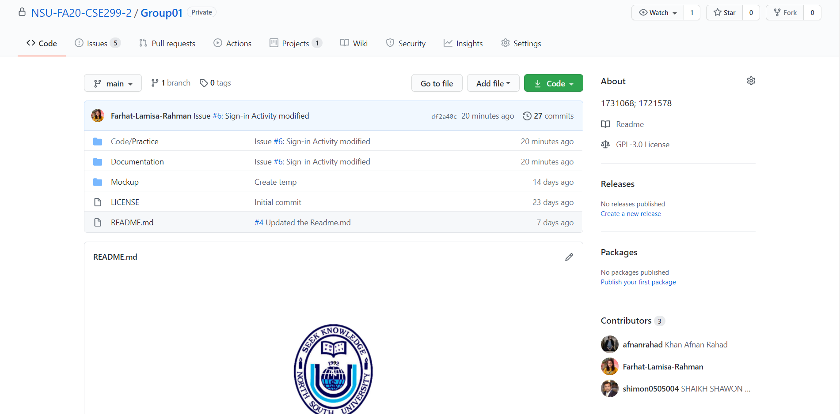
GitHub Front Page

Slide 3
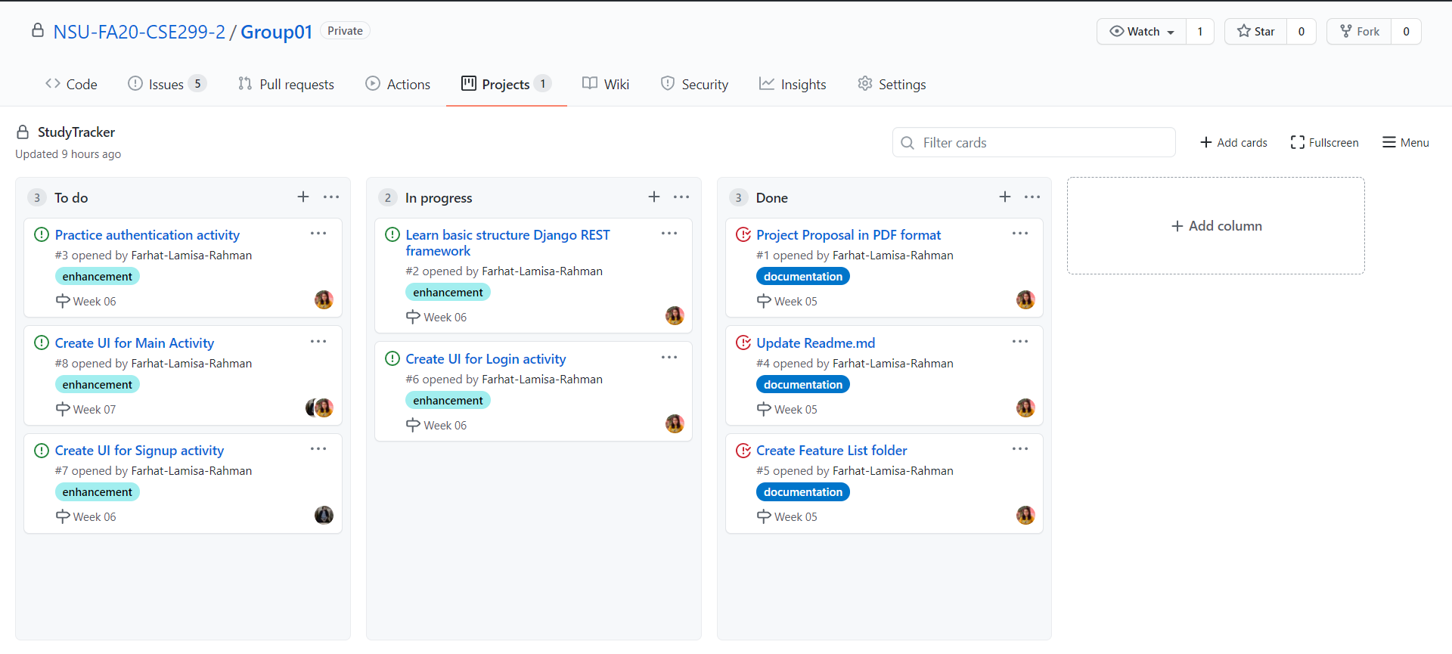
GitHub Board

Slide 4
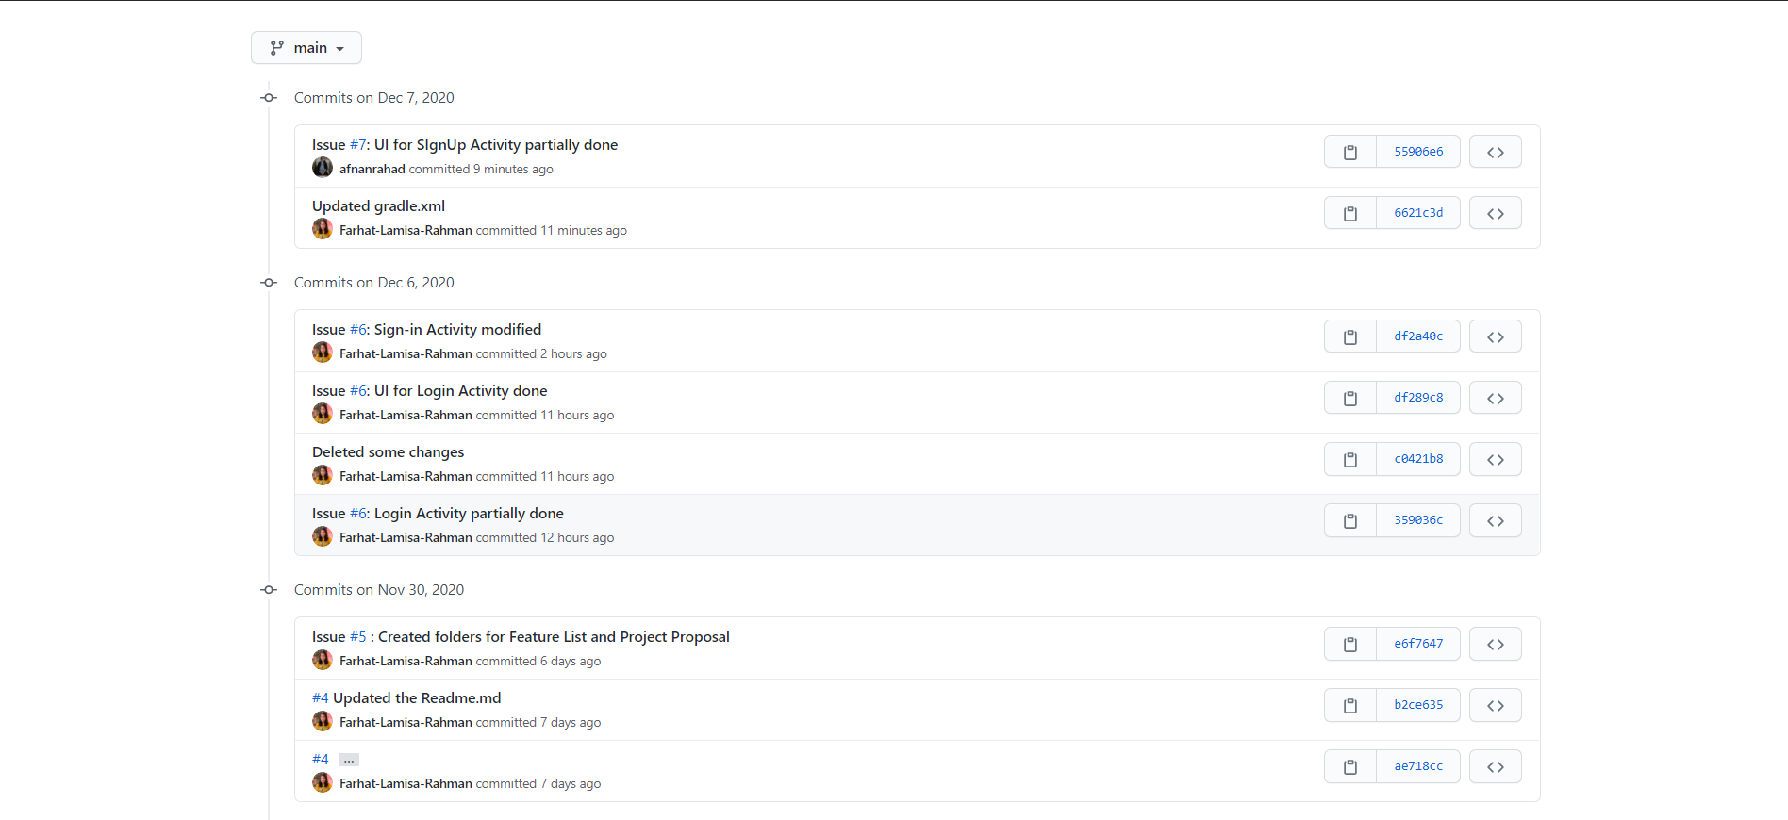
Week 6's commits

Slide 5
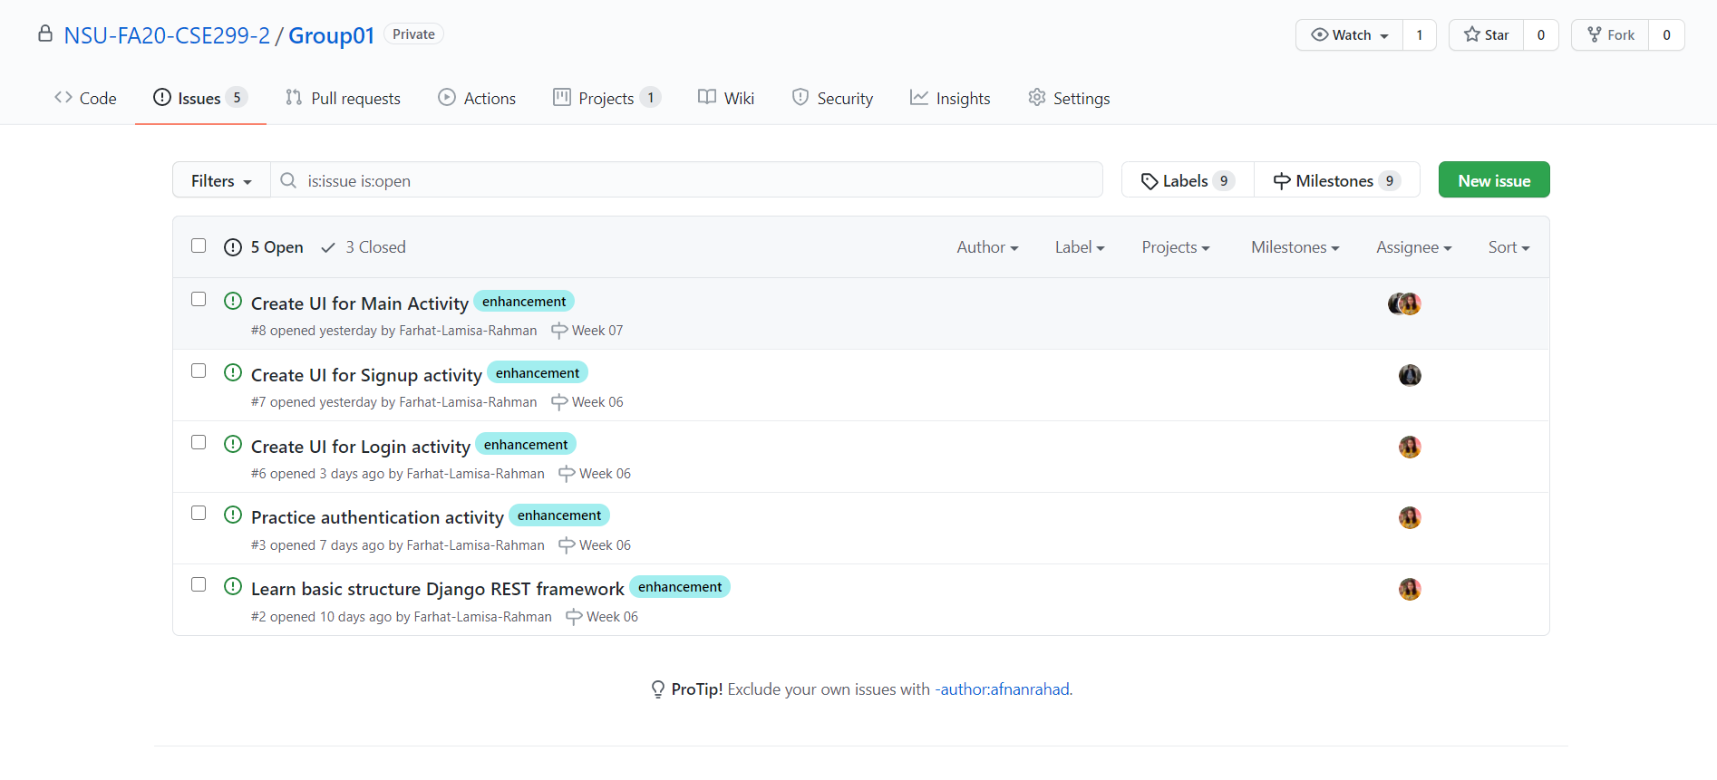
Issues

Slide 6
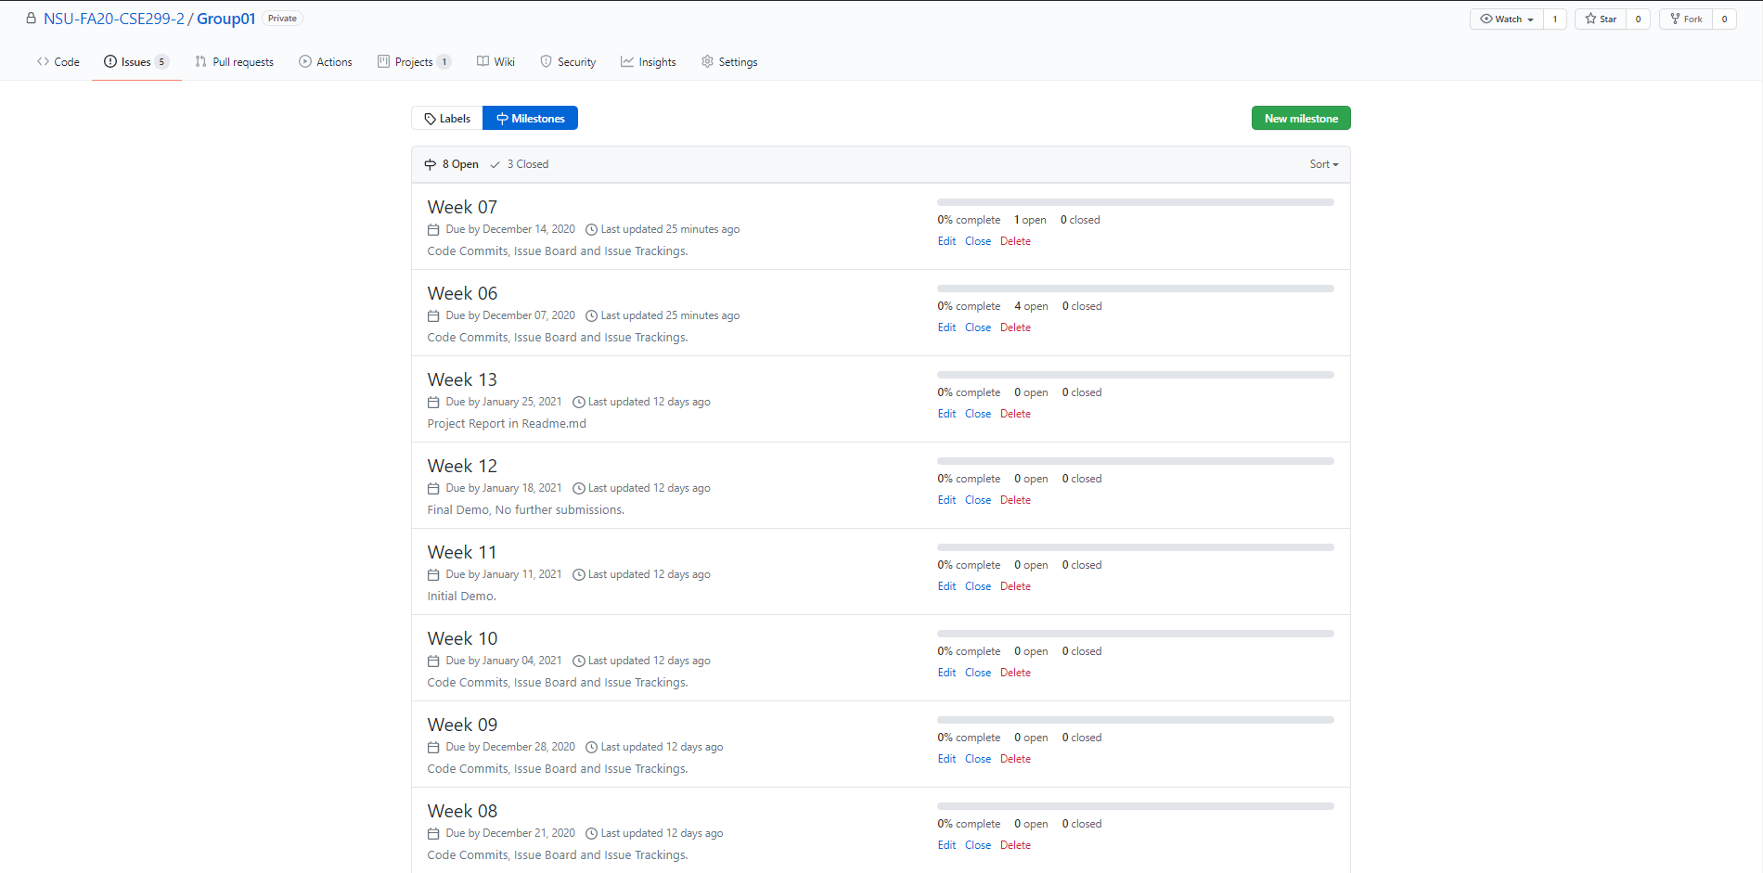
Milestones

Slide 7
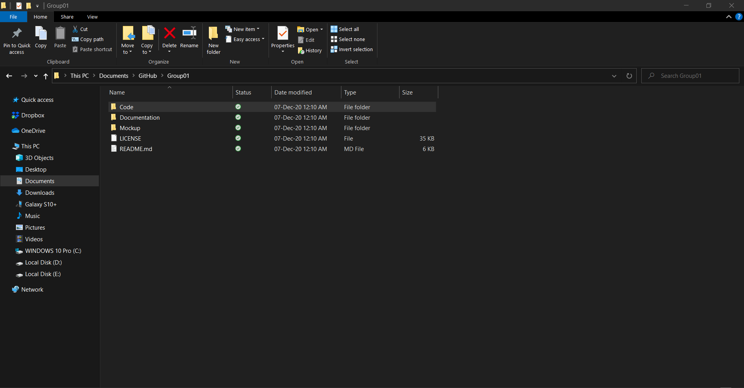
Local Repository

Slide 8
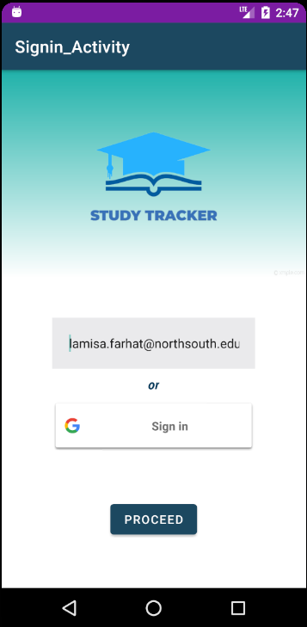
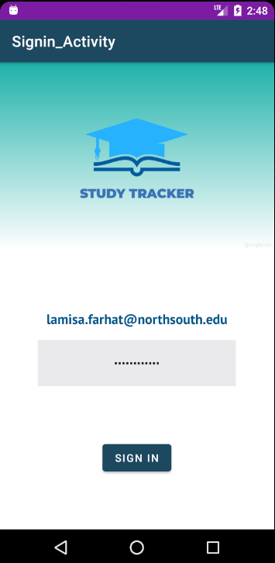
UI for Sign-in Activity

Slide 9
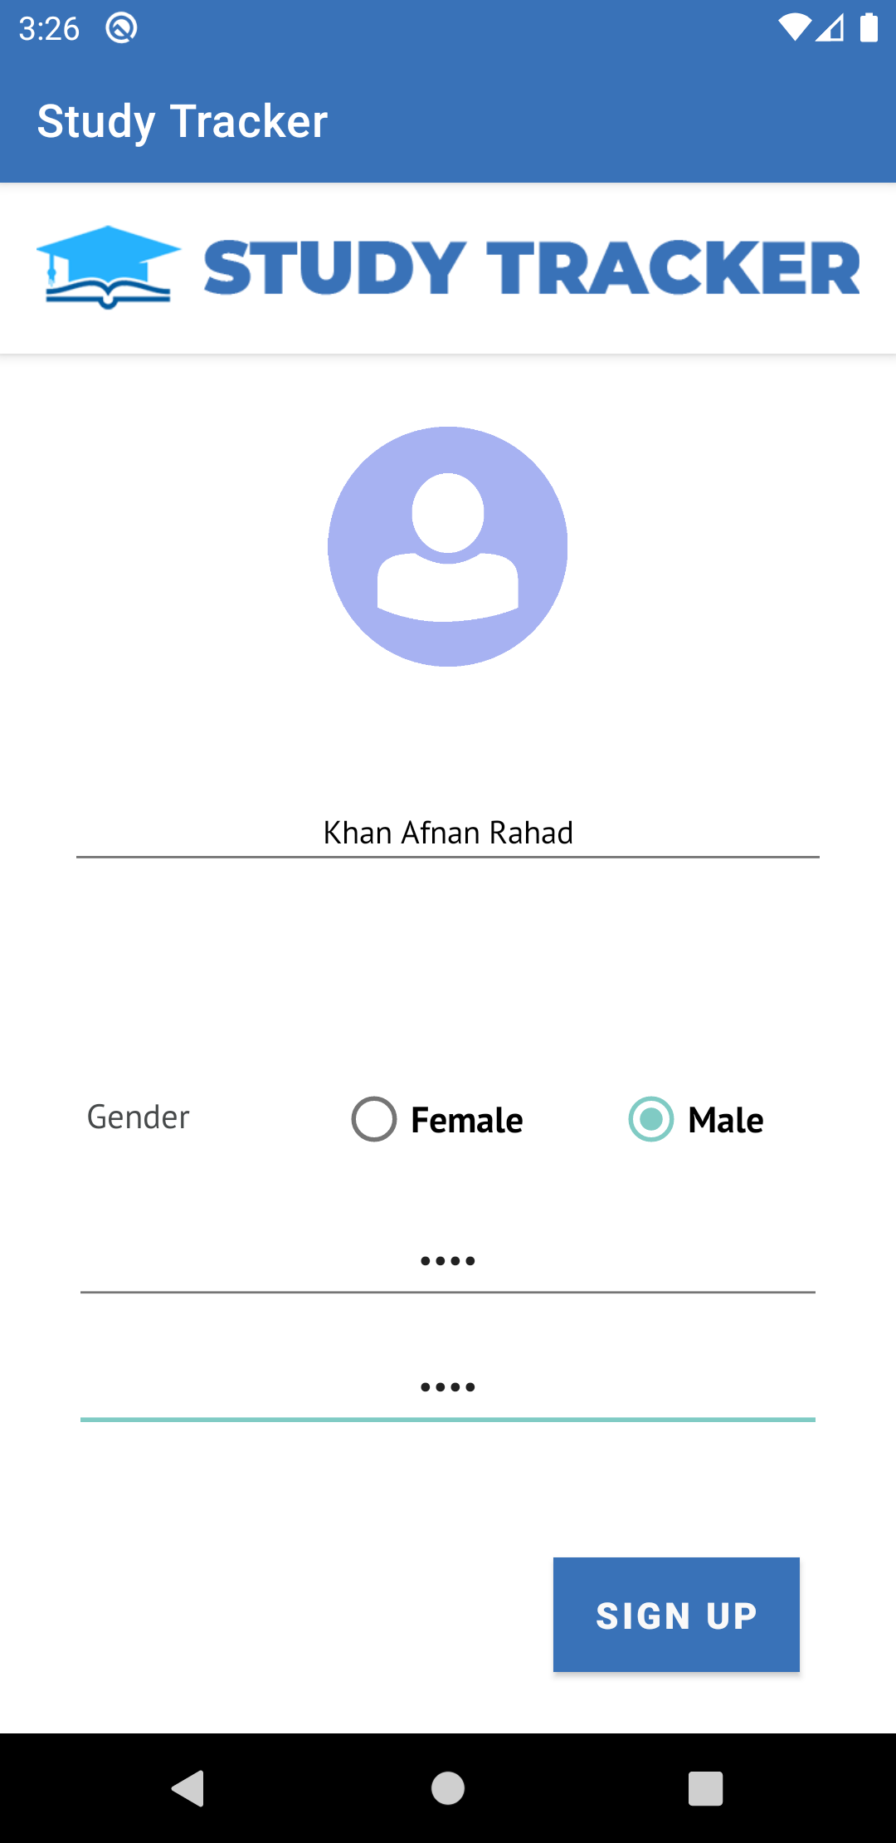
UI for Sign-up Activity

